Slide 1
Object Oriented Programming using Java
SUKKUR IBA UNIVERSITY
Presented By:
Ghulam Mujtaba Shaikh

Slide 2
Introduction to Java

Slide 3
History of Java
Java was conceived by James Gosling, Patrick Naughton, Chris Warth, Ed-Frank and Sheriden at Sun
Micro System in 1991.
First it was called as Oak. But Later on renamed as Java in 1995.
Java is purely Object Oriented Programming Language (OOPL).

Slide 4
Features of Java
Simple
Secure
Portable
Robust
Multithreaded
Distributed
Supports Unicode

Slide 5
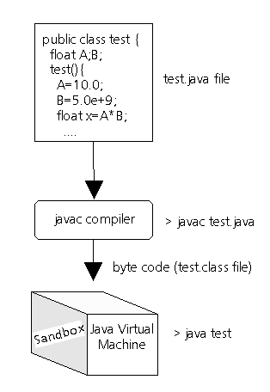
Java’s Magic

Slide 6
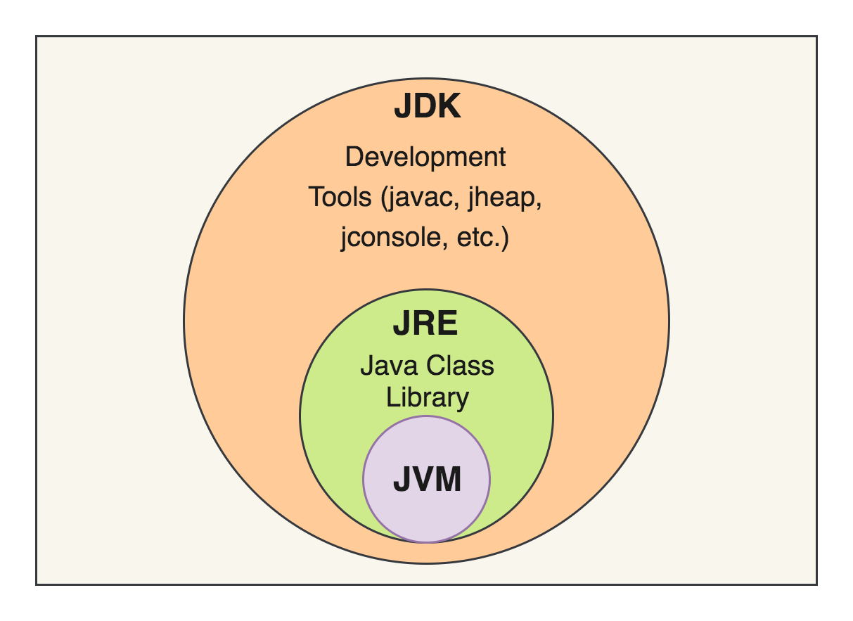
JDK, JRE, JVM

Slide 7
Java Programs
Application Programs
Applet Programs

Slide 8
Java as OOP
OOP
Object
Class
Properties
Methods
Principles of OOP
Encapsulation
Abstraction
Inheritance
Polymorphism
Aggregation
Composition

Slide 9
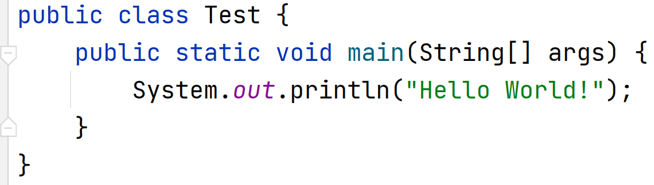
First Program of Java
Note: Difference between main and Main writing.

Slide 10
Public = Access Specifier
Class = Key word for class creation
First = Name of the class
{ = Starting of the class
Public = Access Specifier
Static = Key word
Void = Return Type
Main = Entry point for every java program
String args [] = declares a parameter named args which is an array of class String
{ = Starting of a main
System = Predefine class
Out = Output Stream
Println = Method
} = End of main
} = End of class

Slide 11
Explanation
Type this program in IntelliJ after creating a new project.
Save the project and run the main class (Alt+Shfift+F10).
After successful compilation for executing type following
command.

Slide 12
Recap
Introduction to OOP
Introduction to Java
First program in Java

